Slide 1
Word Vectors
https://github.com/semmi88/teaching

Slide 2
Problem Statement
Machine Learning algorithms work with numbers
How can we represent words, language as meaningful numbers?

Slide 3
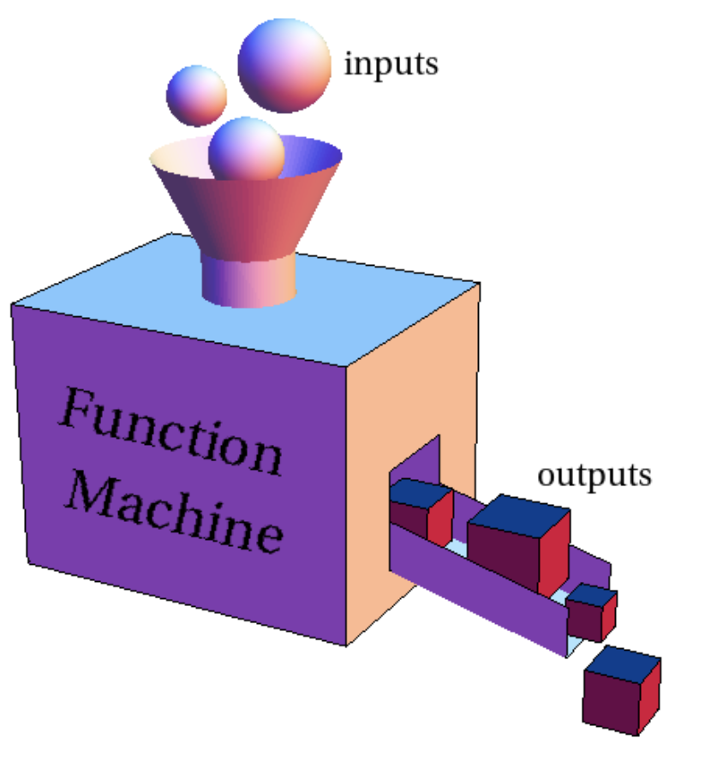


Machine Learning System - Predict house prices
Trained on Dataset
Inputs with corresponding Outputs
Used on new/unseen input data
to predicts possible outputs
House built in year | Area in m^2 | Price in €
1975 | 90 | 200.000
2019 | 70 | 250.000
2002 | 150 | 300.000
Machine Learning System
House built in year | Area in m^2 | Price in € prediction
2022 | 65 | 225.000 ?

Slide 4
Machine Learning System - Training process
1975
Numbers help in giving more information, steering the training process (how close are we?)
90
Machine Learning System
House built in year | Area in m^2 | Actual Price in € | Predicted Price €
1975 | 90 | 200.000 | 15.000
1975 | 90 | 200.000 | 220.000
220K
15k

Slide 5
NLP System - Translation
Trained on Dataset
Inputs with corresponding Outputs
How to represent words meaningfully?
English text | Spanish text
Hello, how are you? | Hola, que tal?
Big dog | Perro grande
Happy birthday! | Feliz cumpleaños!
Machine Learning System
English text | Actual Spanish text | Predicted Spanish text
Big dog | Perro grande | Hola, que tal?
Big dog | Perro grande | Gato grande

Slide 6
Naive Solution
Just use a large dictionary, and assign an ID to each word
English Words | ID
apartment | 1
apple | 2
ball | 3
big | 4
car | 5
cat | 6
chicken | 7
doctor | 8
dog | 9
...
zebra | 10000

Slide 7
Naive Solution
ID numbers suggests that words that are next to each other in the dictionary are similar, but that is not the case
English Words | ID
apartment | 1
apple | 2
ball | 3
big | 4
car | 5
cat | 6
chicken | 7
doctor | 8
dog | 9
...
zebra | 10000
English Words | IDs
big cat | [4, 6]
big car | [4, 5]
big dog | [4, 9]

Slide 8
Issues
How can we encode similarity?
Similar words, should be represented by similar vectors?

Slide 9
Word vectors - intuition
Large size
Let's represent words:
as fixed sized vectors
with dimensions along axis of "meaning"
Small population
Large population
Small size

Slide 10
Word vectors - intuition
Large size
Country | Population (mil pp) | Size (mil km²)
🇫🇷 France | 68 | 0.5
🇪🇸 Spain | 47 | 0.5
🇧🇷 Brazil | 214 | 8.5
🇮🇸 Iceland | 0.4 | 0.1
🇨🇦 Canada | 38 | 9
Small population
Large population
Small size

Slide 11
Word vectors - intuition
Large size
🇨🇦
🇧🇷
Country | Population (mil pp) | Size (mil km²)
🇫🇷 France | 68 | 0.5
🇪🇸 Spain | 47 | 0.5
🇧🇷 Brazil | 214 | 8.5
🇮🇸 Iceland | 0.4 | 0.1
🇨🇦 Canada | 38 | 9
🇪🇸
🇫🇷
Small population
Large population
🇮🇸
Small size
‹#›

Slide 12
Word vectors - intuition
Large size
🇨🇦
🇧🇷
Measured similarity by comparing values along axis
🇧🇷 [0.9, 0.8]
🇫🇷 [0.3, 0.2]
🇪🇸 [0.2, 0.2]
🇨🇦 [-.1, 0.9]
🇮🇸 [-.8, -.8]
🇪🇸
🇫🇷
Small population
Large population
🇮🇸
Small size
‹#›

Slide 13
Word vectors - intuition
Large size
🇨🇦
🇧🇷
Measured similarity by comparing values along axis
🇧🇷 [0.9, 0.8]
🇫🇷 [0.3, 0.2]
🇪🇸 [0.2, 0.2]
🇨🇦 [-.1, 0.9]
🇮🇸 [-.8, -.8]
🇪🇸
🇫🇷
Dot Product similarity
dot(a,b) = a · b = x₁ ✕ x₂ + y₁ ✕ y₂
🇫🇷 · 🇪🇸 = 0.1
🇧🇷 · 🇨🇦 = 0.63
🇧🇷 · 🇮🇸 = -1.36
Small population
Large population
🇮🇸
Small size
‹#›

Slide 14
Word vectors - intuition
Large size
🇨🇦
Normalize by size of vectors, measure similarity by angle
🇧🇷 [0.9, 0.8] - ||🇧🇷|| = 1.2
🇫🇷 [0.3, 0.2] - ||🇫🇷|| = 0.36
🇪🇸 [0.2, 0.2] - ||🇪🇸|| = 0.28
🇨🇦 [-.1, 0.9] - ||🇨🇦|| = 0.9
🇮🇸 [-.8, -.8] - ||🇮🇸|| = 1.13
||a|| = √a · b (Euclidean length of the vector)
🇧🇷
🇪🇸
🇫🇷
Small population
Large population
🇮🇸
Small size
‹#›

Slide 15
Word vectors - intuition
Large size
🇨🇦
Normalize by size of vectors, measure similarity by angle
🇧🇷 [0.9, 0.8] - ||🇧🇷|| = 1.2
🇫🇷 [0.3, 0.2] - ||🇫🇷|| = 0.36
🇪🇸 [0.2, 0.2] - ||🇪🇸|| = 0.28
🇨🇦 [-.1, 0.9] - ||🇨🇦|| = 0.9
🇮🇸 [-.8, -.8] - ||🇮🇸|| = 1.13
||a|| = √a · b (Euclidean length of the vector)
🇧🇷
🇪🇸
🇫🇷
Small population
Large population
Cosine similarity - normalized dot product
cosine(a,b) = a · b / ( ||a|| ✕ ||b|| )
cosine(🇫🇷,🇪🇸) = 0.1 / 0.1008 =0.99
cosine(🇧🇷,🇨🇦) = 0.63 / 1.08 = 0.58
cosine(🇧🇷,🇮🇸) = -1.36 / 1.36 = -0.99
Values go from [-1, 1]
🇮🇸
Small size
‹#›

Slide 16
Key idea 1 - Distributional semantics
Assumption:
two words are similar if they are used in similar context
"a word is characterized by the company it keeps" (J.R. Firth in 1957)

Slide 17
Key idea 1 - Distributional Semantics
Example:
To start my day, I drink hot coffee in the mornings.
Sipping some warm tea helps me wake up in the morning.
Context:
coffee : drink, hot, morning, start my day
tea : sipping, warm, wake up, morning
Let's define a word’s meaning by
its context
its neighboring words
coffee & tea
both a liquid
are consumed warm
early in the day to activate people

Slide 18
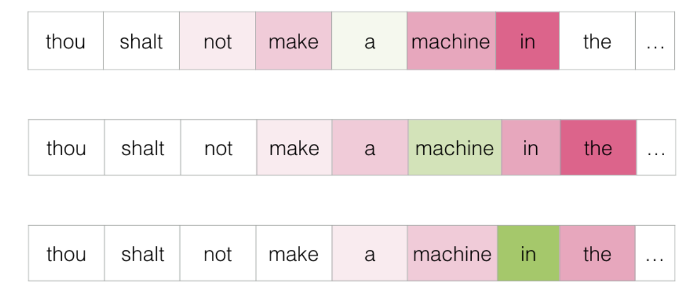
Key idea 2 - Self-supervised learning
Let’s look at words in giant text corpuses and analyze surrounding context:
to find similar words
to automatically determine the “axis of meaning”
and to create a space where the geometry becomes semantically meaningful

Slide 19
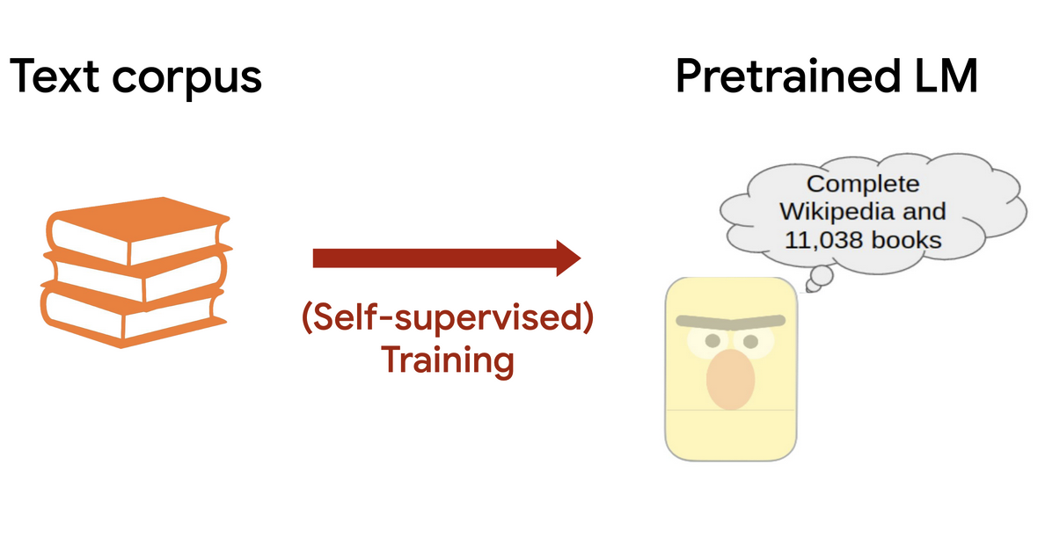
Key idea 2 - Self-supervised learning
If we use a large enough dataset, we will end up with meaningful word vectors (also called word embeddings)

Slide 20
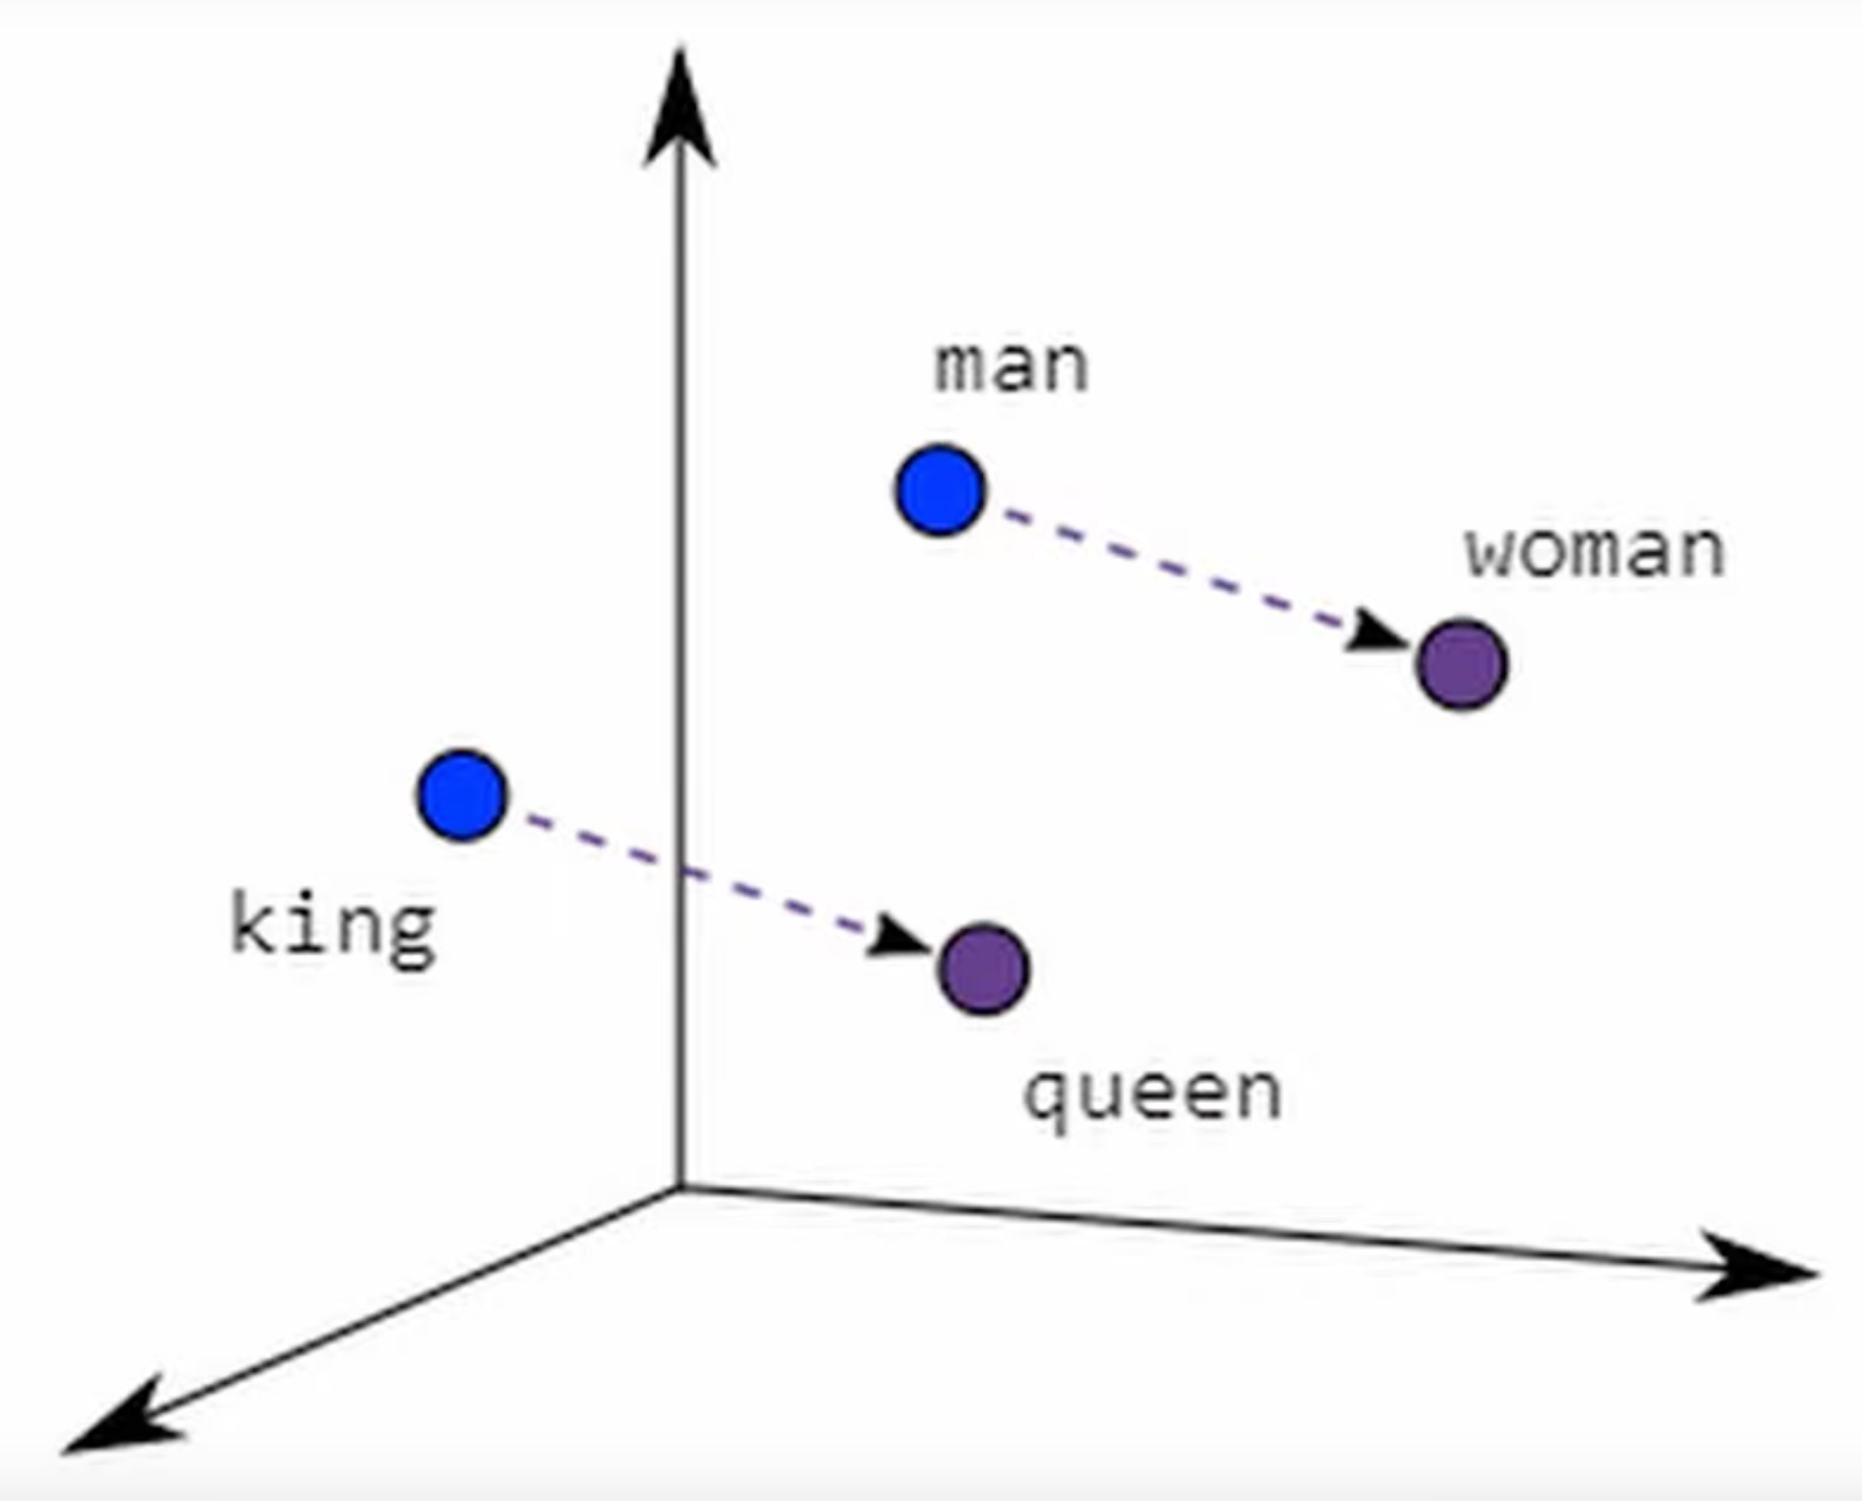
Results

Slide 21
Demo

Slide 22
But why does this work so well?
This is not obvious, there is nothing in the optimization algorithm that should result in these semantically meaningful linear substructures
There are some theories, but we don’t know yet :)

Slide 23
Takeaways
A surprising result - word meaning can be represented well by large vectors of numbers
These vectors can be calculated using a "simple" task of calculating and updating distributional similarities on a large corpus of text

Slide 24
References
Youtube - Computerphile word vectors
Stanford Online: NLP with Deep Learning

